Slide 1
Your more-than-a-Medicare-plan partner
Welcome
PEIP Retirees

Slide 2
HealthPartners Journey (MA) plan for retirees
About the Sanford plan
Coverage type
Includes Medical and Part D (prescriptions)
Predictability
Set copays for most medical services and prescription drugs
Budget-friendly
Annual medical out-of-pocket limits, no deductible and protection for prescription drug costs
Network
For in-network medical services you can see any provider that is part of the Journey (MA) group network; includes all major clinic systems in the Twin Cities and Metro
Plan benefits
Hearing aids, preventive care, travel coverage, fitness benefit, discount programs

Slide 3
Journey (MA) Service Area
2025 Journey Group Service Area
Aitkin Anoka Becker Beltrami Benton Big Stone Carlton Carver Cass Chippewa Chisago Clay Clearwater Cottonwood | Cook Crow Wing Dakota Douglas Grant Hennepin Hubbard Isanti Itasca Jackson Kanabec Kandiyohi Kittson Koochiching | Lac qui Parle Lake Lake of the Woods LeSueur Lincoln Lyon Mahnomen Marshall McLeod Meeker Mille Lacs Morrison Murray | Nobles Norman Otter Tail Pennington Pipestone Pine Polk Pope Ramsey Red Lake Redwood Renville Rice Rock Roseau | Scott Sherburne Sibley St. Louis Stearns Stevens Swift Todd Traverse Wadena Washington Wilkin Wright Yellow Medicine
Journey (MA) Counties
Notes:
In 2024 HealthPartners provides the Journey (MA) group plan in 70 counties – matching the 2023 service area

Slide 4
PEIP Journey (MA) Medical Benefits
Medical Benefits | Plan 1 | Plan 2
Monthly premium | $285.90 | $302.60
Medical Deductible | $0
Annual out-of-pocket maximum | $3,500 (medical only) $5,000 (combined in & out of network)
Out of network cost sharing | 40% coinsurance
Routine exams | Preventive care | You pay nothing
Primary & Convenience care | You pay nothing
Inpatient & Outpatient hospital | $200 copay
ER | $75 copay
Specialty & Urgent care | $35 copay
Diagnostic radiology (MRI CT Pet) | $100 copay
Virtuwell | Unlimited, $0 member cost
Notes:
PEIP offers 2 HealthPartners plan designs, so you can decide which option is best for you.
The plans continue to have routine exams, cancer screenings and preventive care covered at 100%.
You will see here cost sharing amounts are dependent on which plan you choose.
For more details on cost sharing please reach out to Innovo Benefits –contact information highlighted at the end of this presentation.

Slide 5
PEIP Journey (MA) Part D Benefits
Prescription Drug (Part D) | Plan 1 | Plan 2
Deductible | $300 | $0
Tier 1: Preferred generic | $4 copay | $5 copay
Tier 2: Generic | $10 copay | $10 copay
Tier 3: Preferred brand | $47 copay | $47 copay
Tier 4: Non-preferred drugs | 50% coinsurance | 25% coinsurance
Tier 5: Specialty | 27% coinsurance | 25% coinsurance
Preferred cost-sharing mail-order: Get a three-month supply for just two copays
5

Slide 6





Personal support
Member Services
24/7 CareLineSM Service
Nurse NavigatorSM Program
Behavioral Health Navigators
Notes:
Quick advice from our team of experts. Don’t spend time searching the Web for answers. As a member, you have a personal support team as your trusted resource.
Member Services: For questions about your plan benefits, account balance or finding a doctor in your network.
CareLineSM Service (staffed by registered nurses): To find out if you should see a doctor, ask questions about a medicine you're taking, or learn about home treatment options
Nurse NavigatorSM Program: If you have questions about your health care and benefits, or need help choosing a treatment option
Behavioral Health Navigators: Support for mental or chemical needs and benefits, or choosing a treatment option

Slide 7

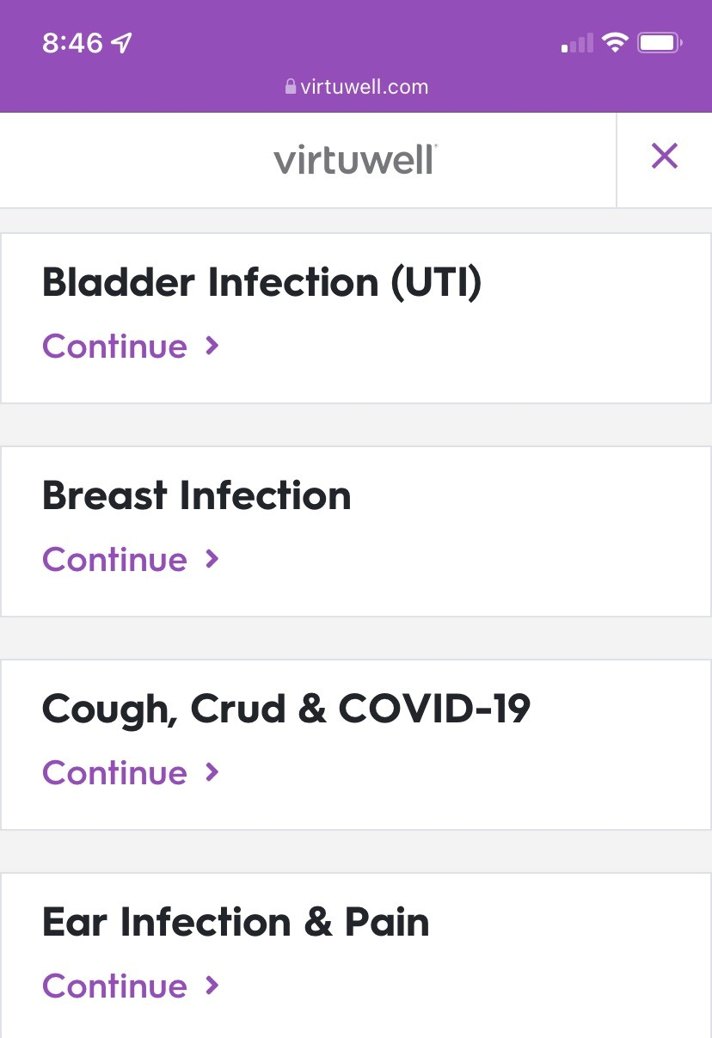
Virtuwell®
Easy, fast and free
Answer a few questions anytime, anywhere.*
Treatment plan and prescription from a nurse practitioner in about one hour.
More than 60 common conditions.
Your medical plan pays for your visits and treatment. Plus, follow-up calls about your treatment are free.
Notes:
Virtuwell is available to you at no cost. You don't have to leave your home to get care. It is available through your smartphone, tablet, or computer by simply going to virtuwell.com. Keep in mind if you are prescribed a medication when accessing care through virtuwell, the prescription can be sent directly to your pharmacy –now that’s efficient when you are not feeling your best.

Slide 8

SilverSneakers®
Reach your health and fitness goals with the SilverSneakers fitness program
Flexible format: in-person, online, mobile, at-home kits
Thousands of fitness locations across the country
Online classes designed for seniors
Extra tools, coaching, and training
SilverSneakers® is a registered trademark of Tivity Health, Inc.
© 2021 Tivity Health, Inc. All rights reserved.
Silversneakers.com/starthere
Notes:
SilverSneakers is your fitness partner, available at no cost for a basic membership.
With nationwide access to over 16,000 facilities in the network -you can simultaneously join multiple gyms.
So attend your favorite yoga class at one facility and go to another for tennis.
Fitness benefits have been expanded to include online classroom, coaching, and other services too.

Slide 9

Hearing aids
Access through TruHearing provider
Two each year ~ one per ear
Pick your cost ~ technology/style
$499 | $699 | $999
Quick, simple process
TruHearing dedicated phone number for HealthPartners
833-718-5802
Nationwide service area with over 7,000 providers
Notes:
The TruHearing -hearing aid benefit continues to help you on the road to hearing better
There is a network of providers for this benefit and a TruHearing Consultant can help you find the provider convenient to you.
TruHearing Consultant will answer questions and explain benefits​
If member is ready to set an appointment, consultant will:​
​Find closest provider​
Schedule appointment via 3-way call​
Appointment/Hearing Aids​
​Member receives audiogram and discusses hearing aid options​
Member places order and makes copayment for aids at provider’s office​
Hearing aids arrive in 2-7 days
Style, Features or technology -would all determine your cost:
The cost of your hearing aid includes that professional exam, unlimited follow-up visits, a 60 day risk-free trial period and 3-yr manufacture's warranty –
Contact a consultant at TruHearing to get started.
TruHearing’s website at www.truhearing.com

Slide 10





Travel coverage
Visitor/Traveler benefit
Worldwide coverage
Medical consultation
Assist America®

Slide 11





Assist America®
Coordinates transport to care facilities
or back home
Fills lost prescriptions
Finds quality care
Helps with hospital admission
Provides translator referrals
assistamerica.com
Notes:
Assist America: You’ll receive support if something unexpected happens while you’re more than 100 miles from your home or in a foreign country. You can call 24/7 nationwide and worldwide to speak with experienced clinicians who can help determine your need for medical care, and coordinate any post-stabilization transportation to the nearest facility or your home.
This service is only available during the first 90 consecutive days that you are away from your home and all arrangements must be made through Assist America.

Slide 12



Enrolling with HealthPartners Medicare
Whether you switch to HealthPartners Medicare group plan
Or
Are new to Medicare?
Call Innovo Benefits for guidance
952-746-3101 or 800-829-5601
Return completed enrollment form to Innovo Benefits
Watch for your new member packet to come in the mail

Slide 13

New to retiree group?
Apply for Medicare Part A & B
Here to help.
Call Innovo with questions
Call Innovo Benefits
with any questions along the way.
Complete application
Watch for new member packet

Slide 14


What to expect next
You have guaranteed plan renewal for 2025
Current members don’t have to do anything
Annual Notice of Change (ANOC) letter
Regulatory and plan benefit updates
No new ID cards issued
Do you need to create your online
myHealthPartners account?
NOW YOU CAN
Sit Back. Relax. Know you are covered.

